Slide 1

Building a School-based LMS with Google Suite for Edu.
Jockey Club Ti-I College
14 Dec 2017
Learning & Teaching: Expo. 21C Classroom

Slide 2
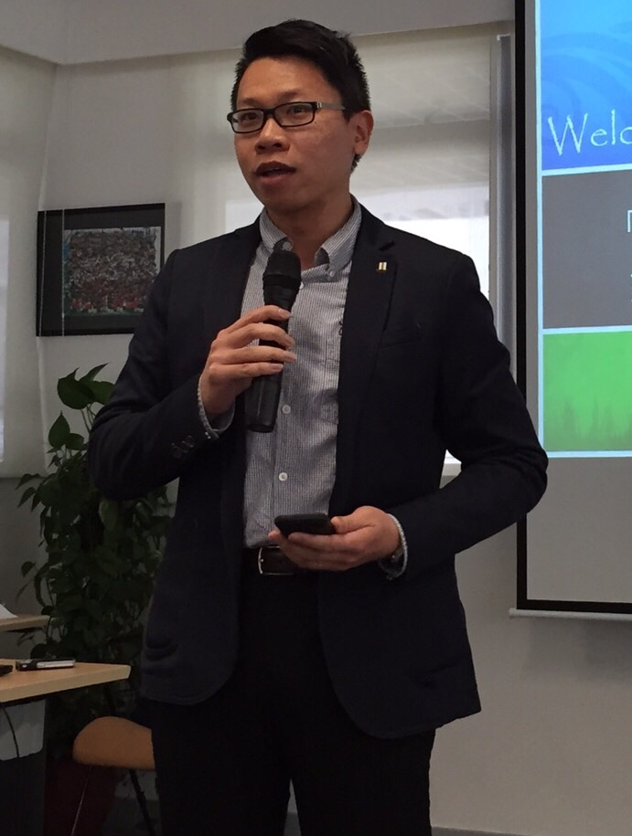
About Us:
Name: Mr. CHAN Wai-leung, Stephen
Title: Assistant Principal
Contact: stephen@tic.edu.hk
Mobile: 9370-4365
Office: 2691-7150 Ext: 8130
Name: Mr. LIE Chi-wai, Kevin
Title: Deputy ICT Panel Head
Contact: kevin@tic.edu.hk
Mobile: 6468-5821
Office: 2691-7150 Ext: 8097

Slide 3
Content:
The development of a school-based LMS with GSFE
Cross-platform BYOD
Hands-on: eLearning @JCTIC

Slide 4
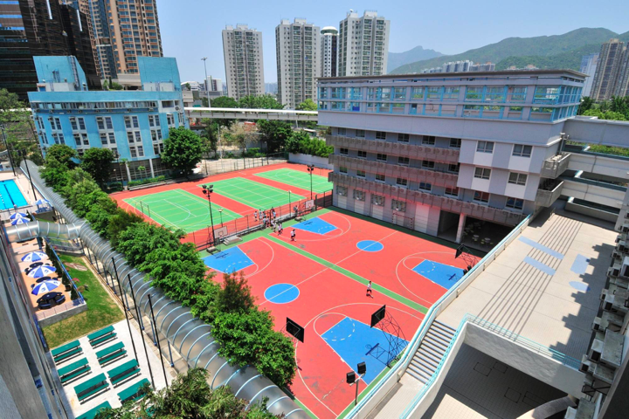
Jockey Club Ti-I College

Slide 5
About Us:
29-year subsidized EMI school with specific school missions (Sports and Visual Arts)
100% discretion, Territory-wide student intake
Mostly Band 1 students
Spacious non-standard school campus
66 teachers (average age around 40)
Harmonious staff culture and low turnover rate

Slide 6
About Us:
Principal - Mr. Vincent CHENG (principal@tic.edu.hk)
Sch. Admin. / Evidence-based L&T supported
with self-developed ICT Systems
Wi-Fi900A, with 100 AP, BYOD started in 15-16
A relatively young subsidized school lacks strong financial support from IMC or Alumni

Slide 7

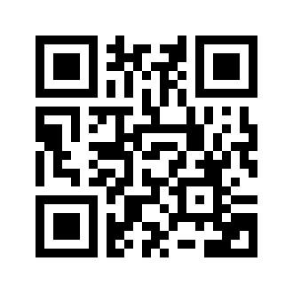
1. The development of A school-based LMS with Google Suite for Education
http://hub.tic.edu.hk

Slide 8









So many LMS, some are even free.
Why build something on your own?

Slide 9
User Management
(SSO: Google Suite for Education, Windows AD, HKEdCity, …...)
Learning Curve
(teachers, not students)
Accessibility
Sharing among Teachers
Social elements
School hosted vs Cloud
Storage Limit
Cost

Slide 10
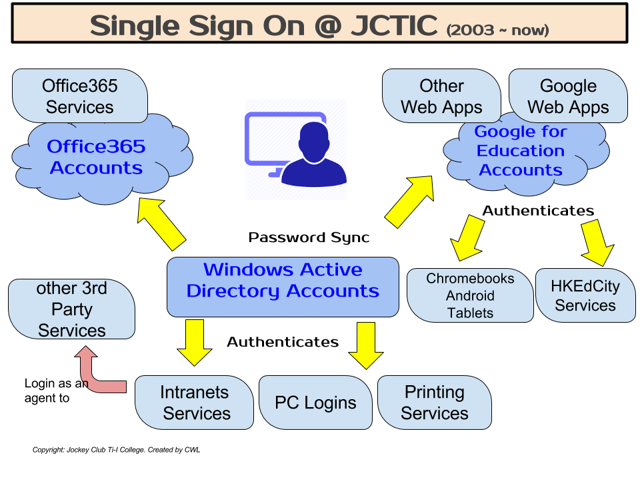

Slide 11
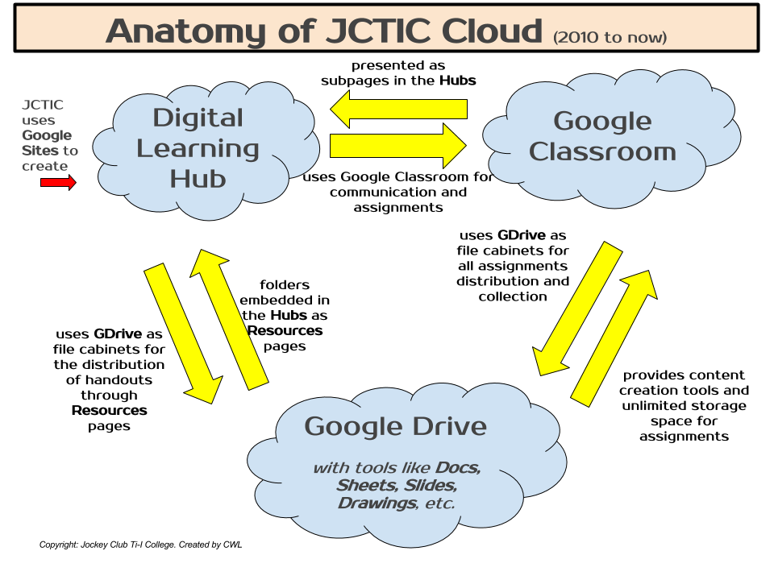

Slide 12
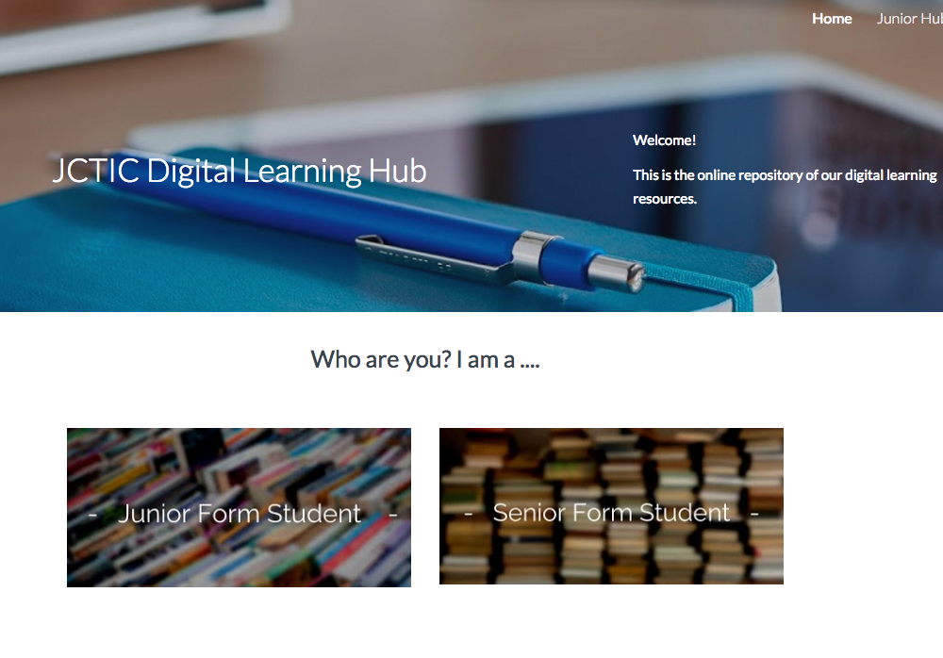
Index page build with New Google Sites.

Slide 13
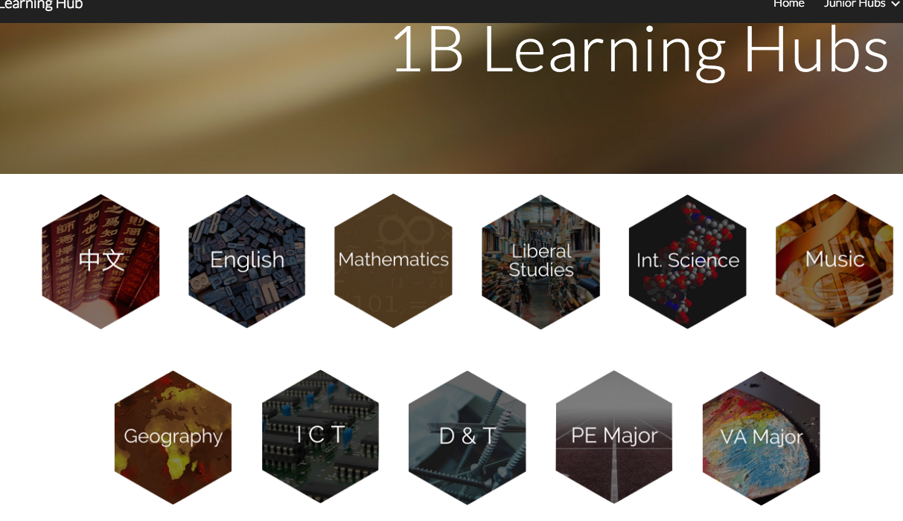
Index page for each class. Simple index with subjects.

Slide 14
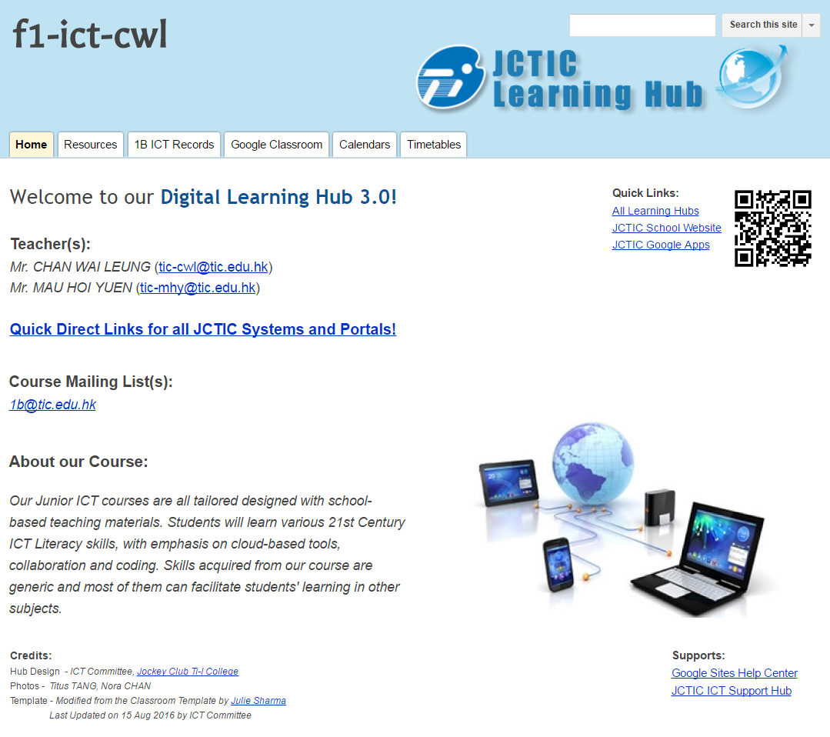
Pre-defined tabs for all Hubs
Build one Site, mass copy to all
Set permissions
Properly indexed on the main page
Teachers can add their own if they want.

Slide 15
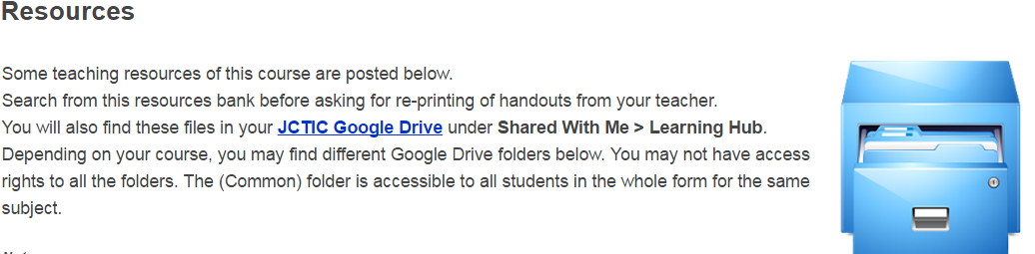
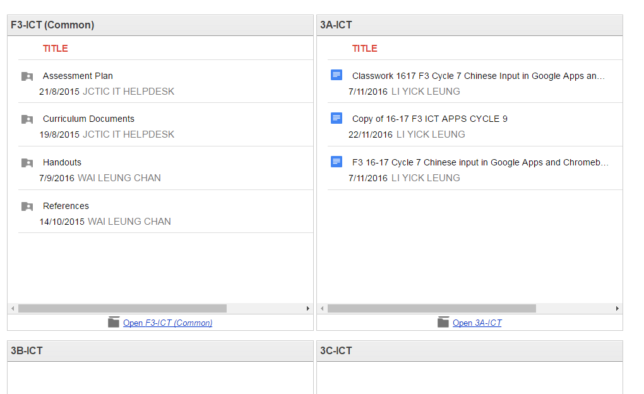
Common GDrive Folders
for the whole Form.
Specific GDrive Folders for a particular class.
Links to open the folder directly in GDrive.
GDrive Folder "Widget" inserted in Google Sites

Slide 16

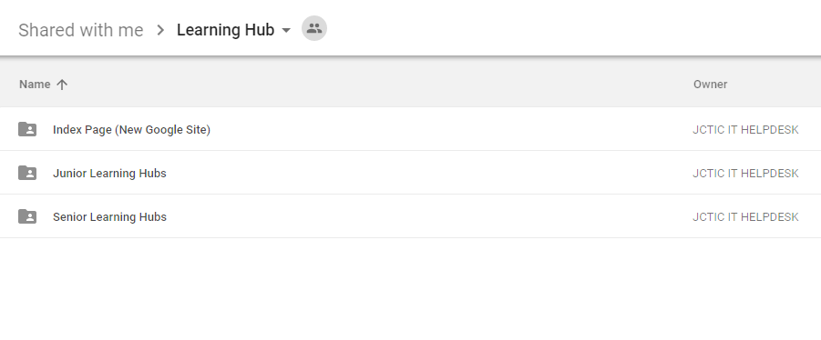
All teaching resources are centralized.
All teachers will find the GDrive Folders to all hubs
Folders are created with admin account.
Avoid ownership problems.
All other hub folders are properly categorized through a folder structure.

Slide 17
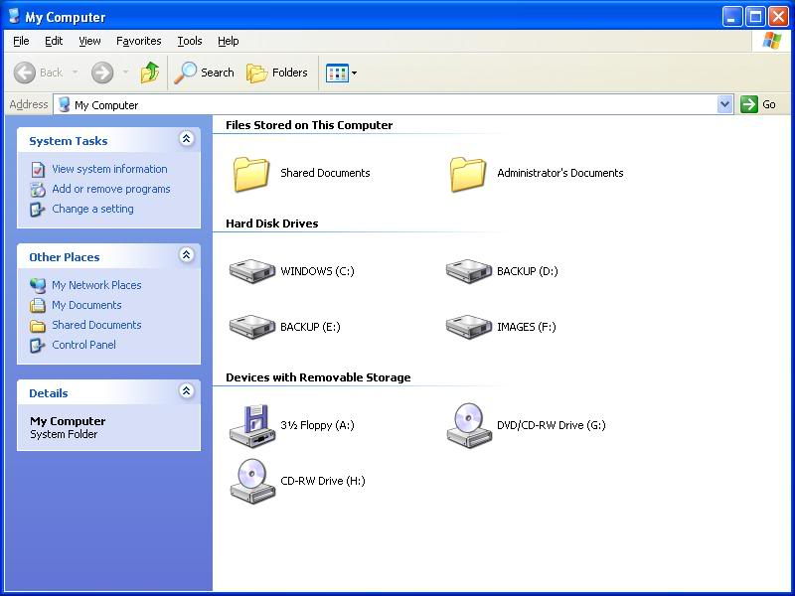
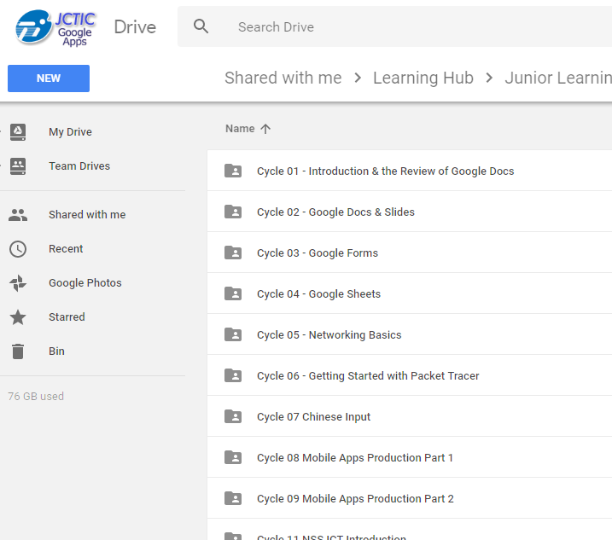
Upload Handouts through simple DRAG and DROP!
My Computer
ALL teachers can handle!
Browser

Slide 18
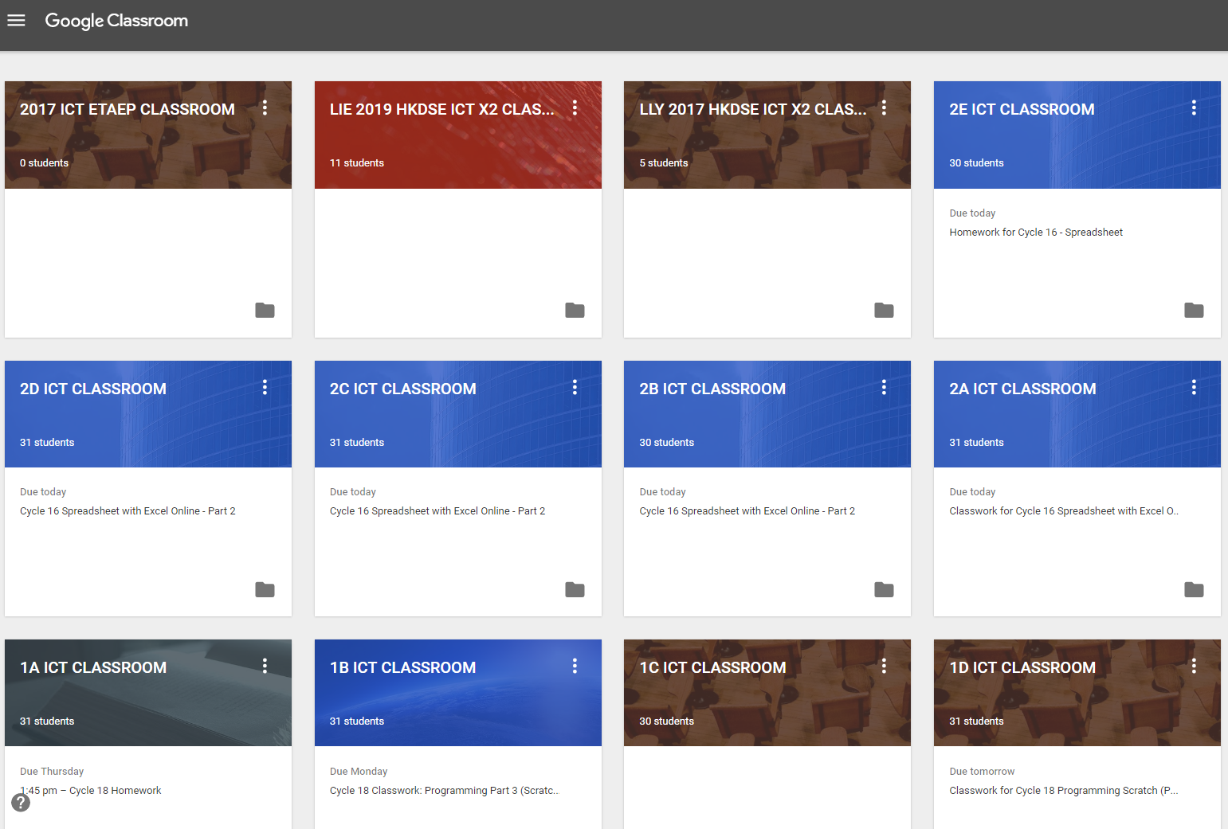
All users see all their Google Classrooms automatically.
no codes to fill,
no enrollment problems
no "I don't know how to"
i.e. no excuses

Slide 19
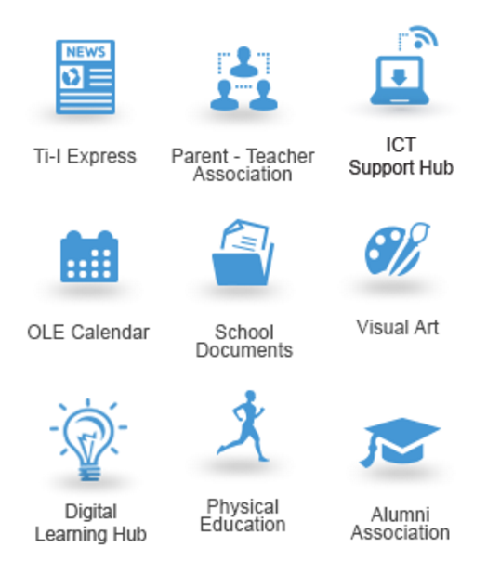
Live Demonstrations
(if time allows)
http://hub.tic.edu.hk
http://www.tic.edu.hk
http://ict.tic.edu.hk
http://classroom.google.com

Slide 20


2. BYOD - A Cross-platform Approach

Slide 21
School Policy - BYOD
Students are NOT compulsorily required to bring a computer/tablet to school at all times.
The Wi-Fi 900 is a way to enable students to access the Digital Learning Hub so that they can download the work provided by teachers and engage in Self-Directed Learning.
It is about providing for students the opportunity to become more active and engaged learners.

Slide 22
Definition of Devices
MacBooks
Laptops
…….
Wi-Fi capable Tablets
iPads
e-Readers
Chromebooks :)

Slide 23

Smartphone in Campus:
Smartphones are not defined as
Learning Devices

Slide 24


Use of devices in Campus:
Students are allowed to use their own device
under teachers' supervision only

Slide 25

Cross-platform ? Mac vs Windows, iOS vs Android
JCTIC eLearning:
Digital Learning Hub
Google Classroom
Google Drive
Google Docs
Office365…..
Most are Web Services in JCTIC running on a Web Browser.
e.g. GOOGLE CHROME

Slide 26
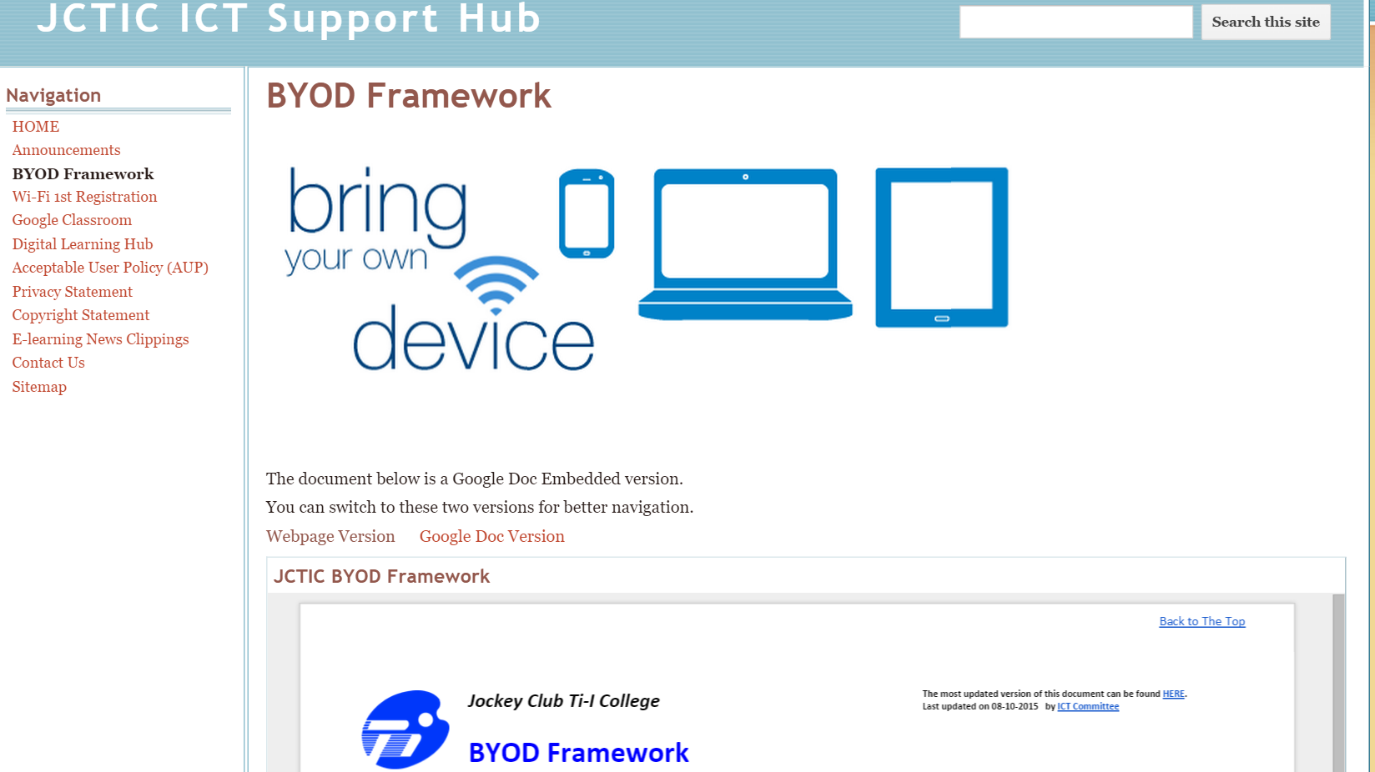
BYOD Framework

Slide 27
BYOD Framework
JCTIC IT AUP, Privacy Statement and Copyright Statement
Coverage and Design
Device Registration, User Access Rights and Authentication
Central Monitoring System and Users’ Conduct
Use of Own Devices
School Mobile Learning Devices
Web Content Filtering on JCTIC Networks
Insurance, liability & Security of Devices
Disciplinary Measures related to the Misuse / Abuse of JCTIC Wi-Fi System
Misuse of the Service and Getting Help
FAQ for Teachers
FAQ for Students
FAQ for Parents

Slide 28
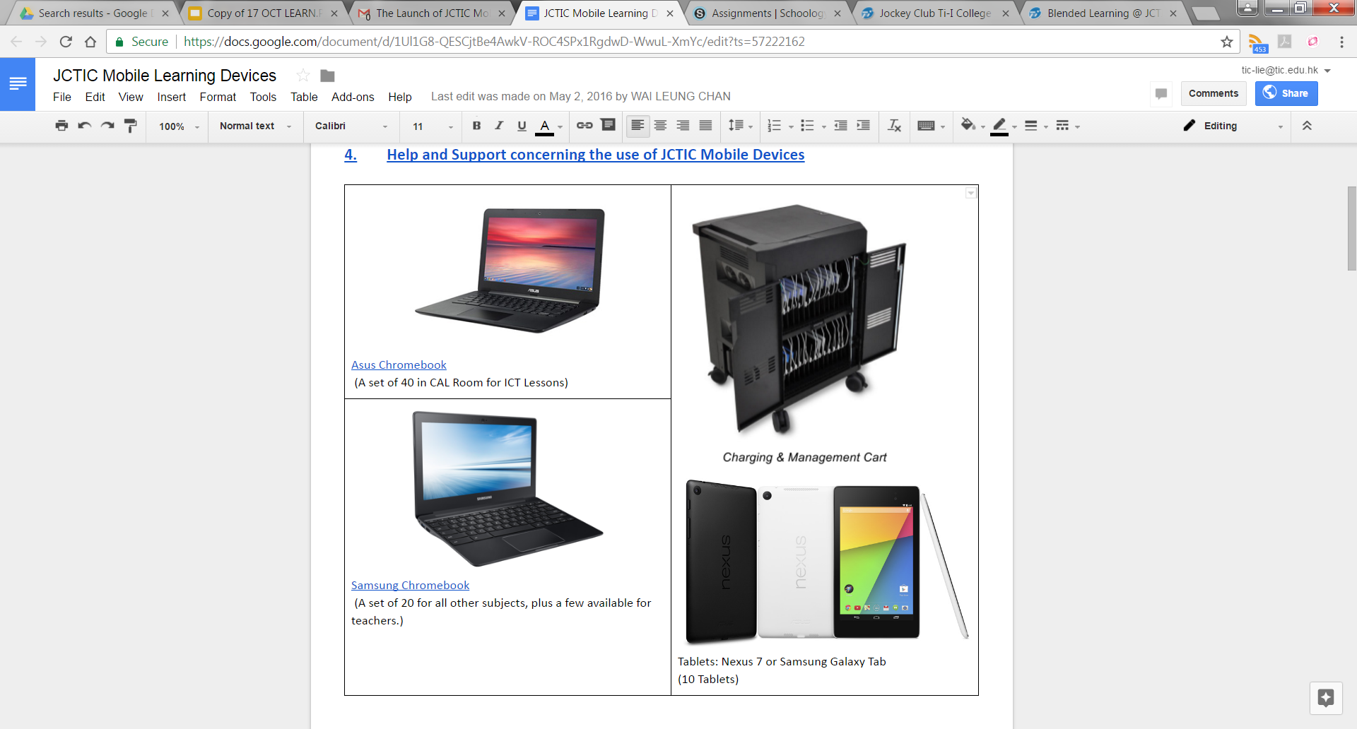
Mobile devices provision

Slide 29
Subject Support
In order to enhance the ICT support to subjects, a subject ­based ICT Support Coordinator is assigned to each subject.
ENG BIO IS VA CHI CL PE HIST GEO MATHS CHIST PTH CLPE LS ICT DT ECON BAFS PHYSICS CHEM MUSIC
The roles of our subject support coordinators are:
● conduct at least 3 meetings with the panel / panel head
● conduct at least 1 ICT SD Workshop with the panel / panel head
● assist panels in maintaining the Blended Learning Resource Pages
● passing subject ­related Blended Learning Resources to panels

Slide 30
3. Hands-on: eLearning @JCTIC

Slide 31
Digital Learning Hub @ JCTIC
With our Chromebook or your own device,
please visit https://hub.tic.edu.hk
Browse to 1A → 21C Demo Hub
Try to locate the handout for Google Classroom

Slide 32
Google Classroom @ JCTIC
Follow the instructions in the handout you found, complete the Assignments in Google Classroom

Slide 33
End of our sharings.
Thank You!

